Slide 1



Discovering Hidden Personality Patterns
Applying K-Means Clustering to the Big Five Personality Test
By: Sushma Suresh

Slide 2
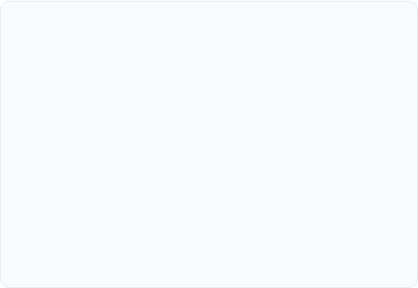
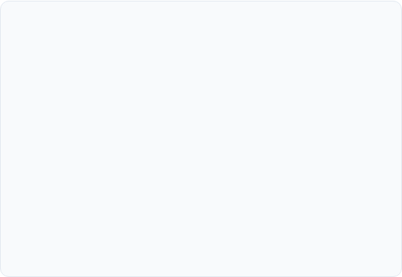
What is the Big Five (OCEAN)?
The OCEAN Model
Project Goal
O - Openness: Curiosity, creativity, and interest in new ideas.
Goal: To use unsupervised learning to find natural personality clusters from over 1 million test responses, without any predefined labels.
C - Conscientiousness: Organization, responsibility, and discipline.
E - Extraversion: Sociability, assertiveness, and emotional expression.
A - Agreeableness: Kindness, cooperation, and empathy.
N - Neuroticism: Emotional instability, anxiety, and moodiness.

Slide 3
A Massive Global Dataset
1M+
Dataset Overview
•
Source: Kaggle "Big Five Personality Test"
•
Data: 50 core personality questions (10 for each OCEAN trait).
Total Participants
•
Scale: Responses were recorded on a 5-point Likert scale, from 1 (Disagree) to 5 (Agree).

Slide 4
Data Preparation & Processing
Cleaning: Dropped irrelevant columns (e.g., time spent per question, IP info) and removed all rows with missing values to create a clean dataset.
Reverse-Scoring: Flipped the scores for all negatively-worded questions (e.g., "I don't talk a lot") so that a high score always indicated a high level of that trait.
Scaling: Applied a `MinMaxScaler` to all 50 numeric features. This normalized all responses to a standard 0-1 range, which is essential for K-Means.

Slide 5
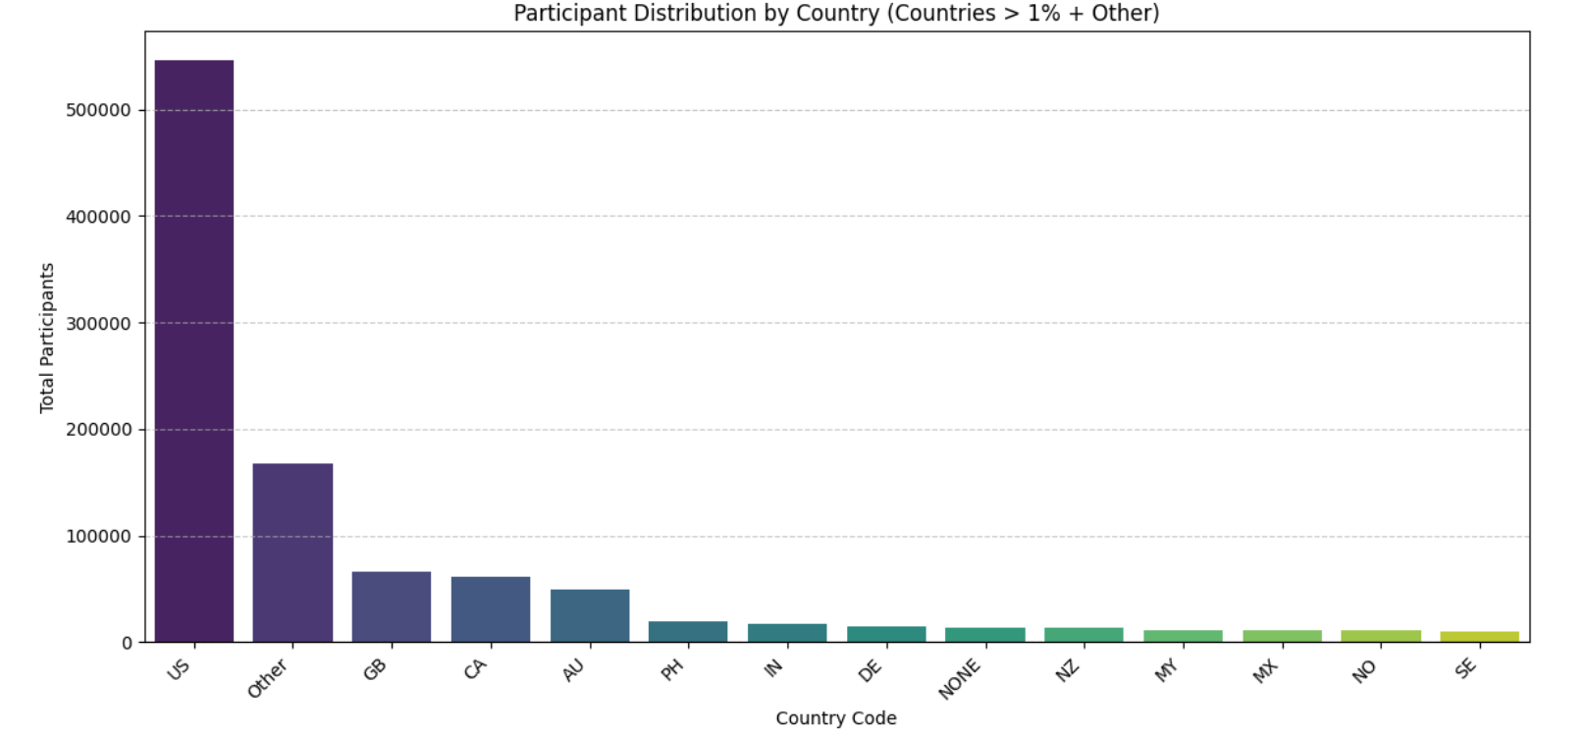

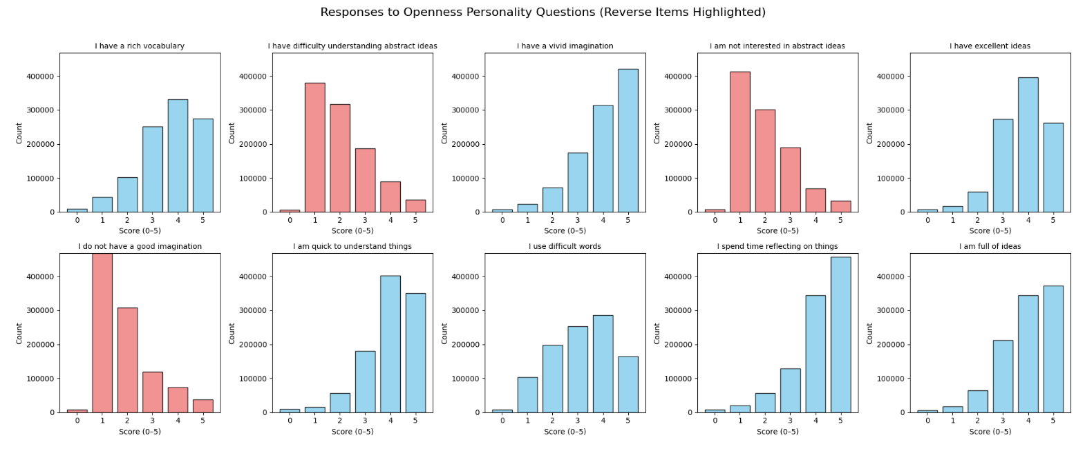
EDA: Understanding Trait Distributions
Identifying Response Patterns
* Data distribution of all the countries
* Exploratory Data Analysis (EDA) involved plotting the response distributions for all 50 questions.
•
Openness
•

Slide 6
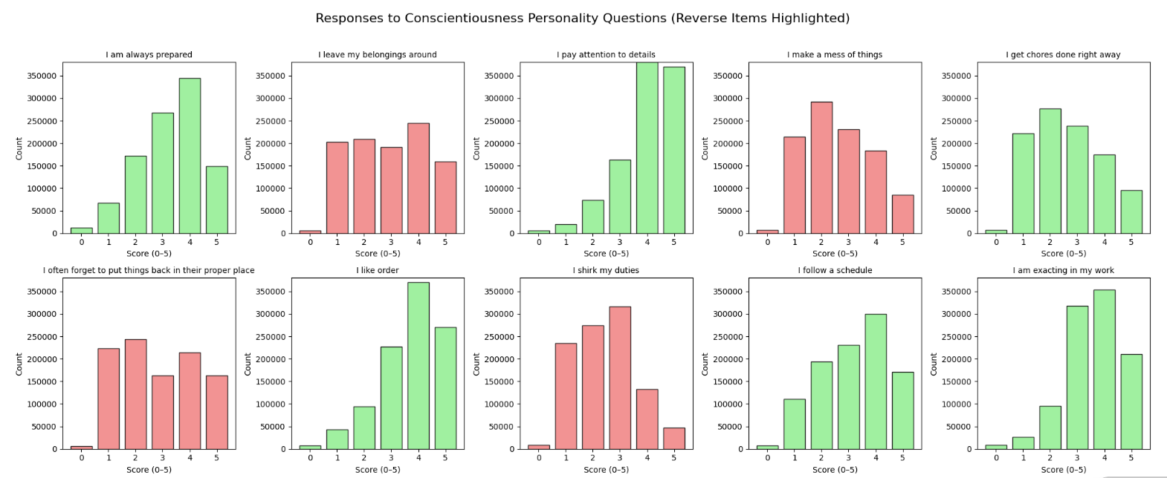
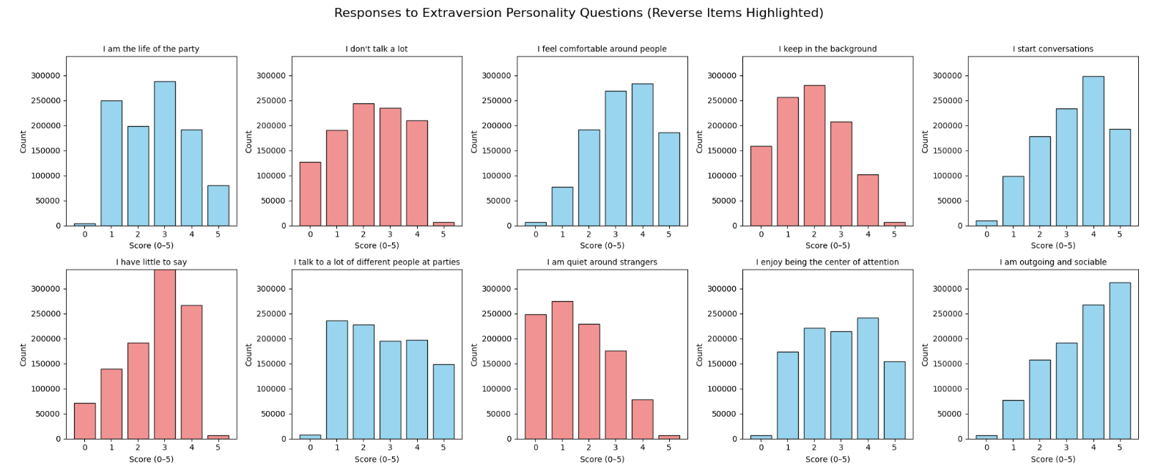
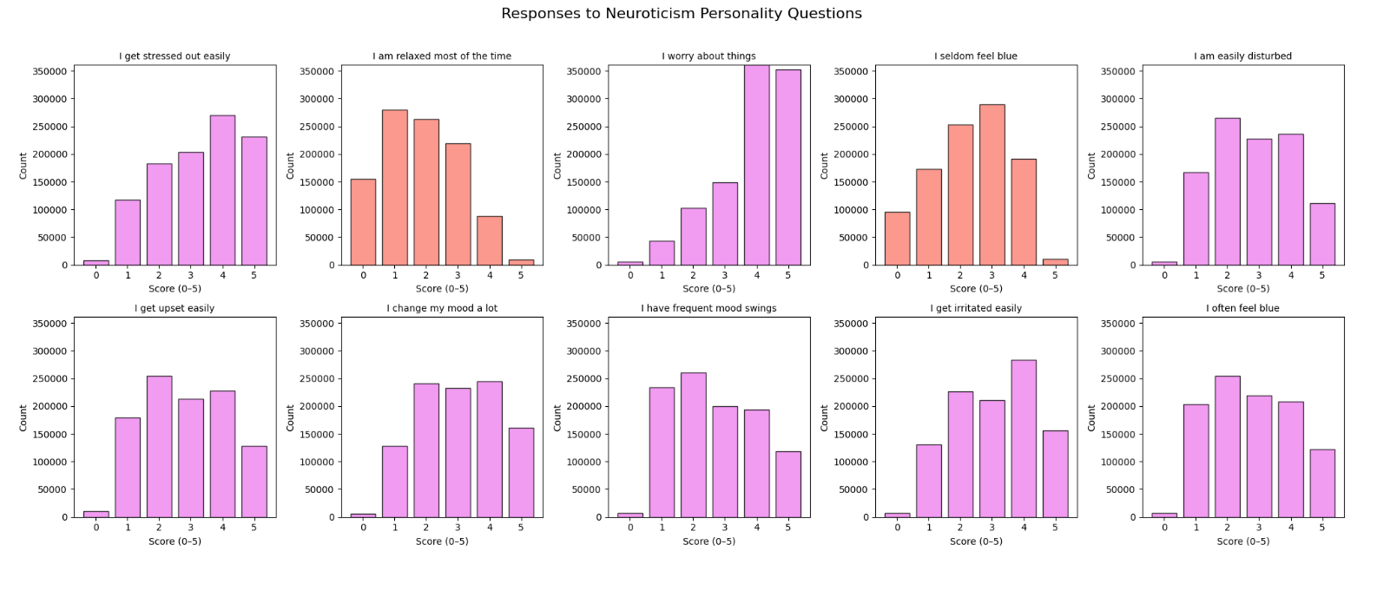
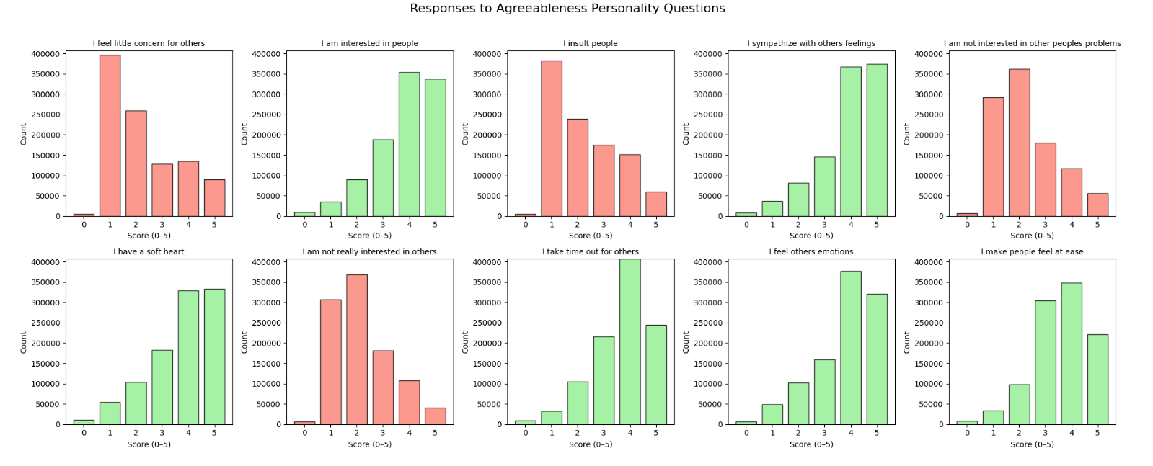
Conscientiousness
Extraversion
Agreeableness
Neuroticism

Slide 7
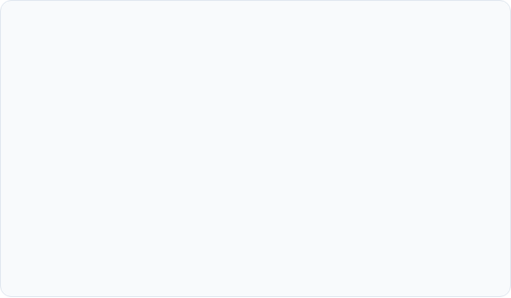

Methodology: From 50 Questions to 3 Clusters
1. Feature Engineering
2. Clustering
The 10 scaled scores for each trait (e.g., EXT1-EXT10) were averaged together. This condensed the 50 individual question columns into the 5 final features used for clustering: **Extraversion, Neuroticism, Agreeableness, Conscientiousness, and Openness**.
The **K-Means** algorithm was then applied to this 5-feature dataset. The goal was to partition the 1 million participants into a small number of groups (*k*) based on their shared personality profiles.

Slide 8
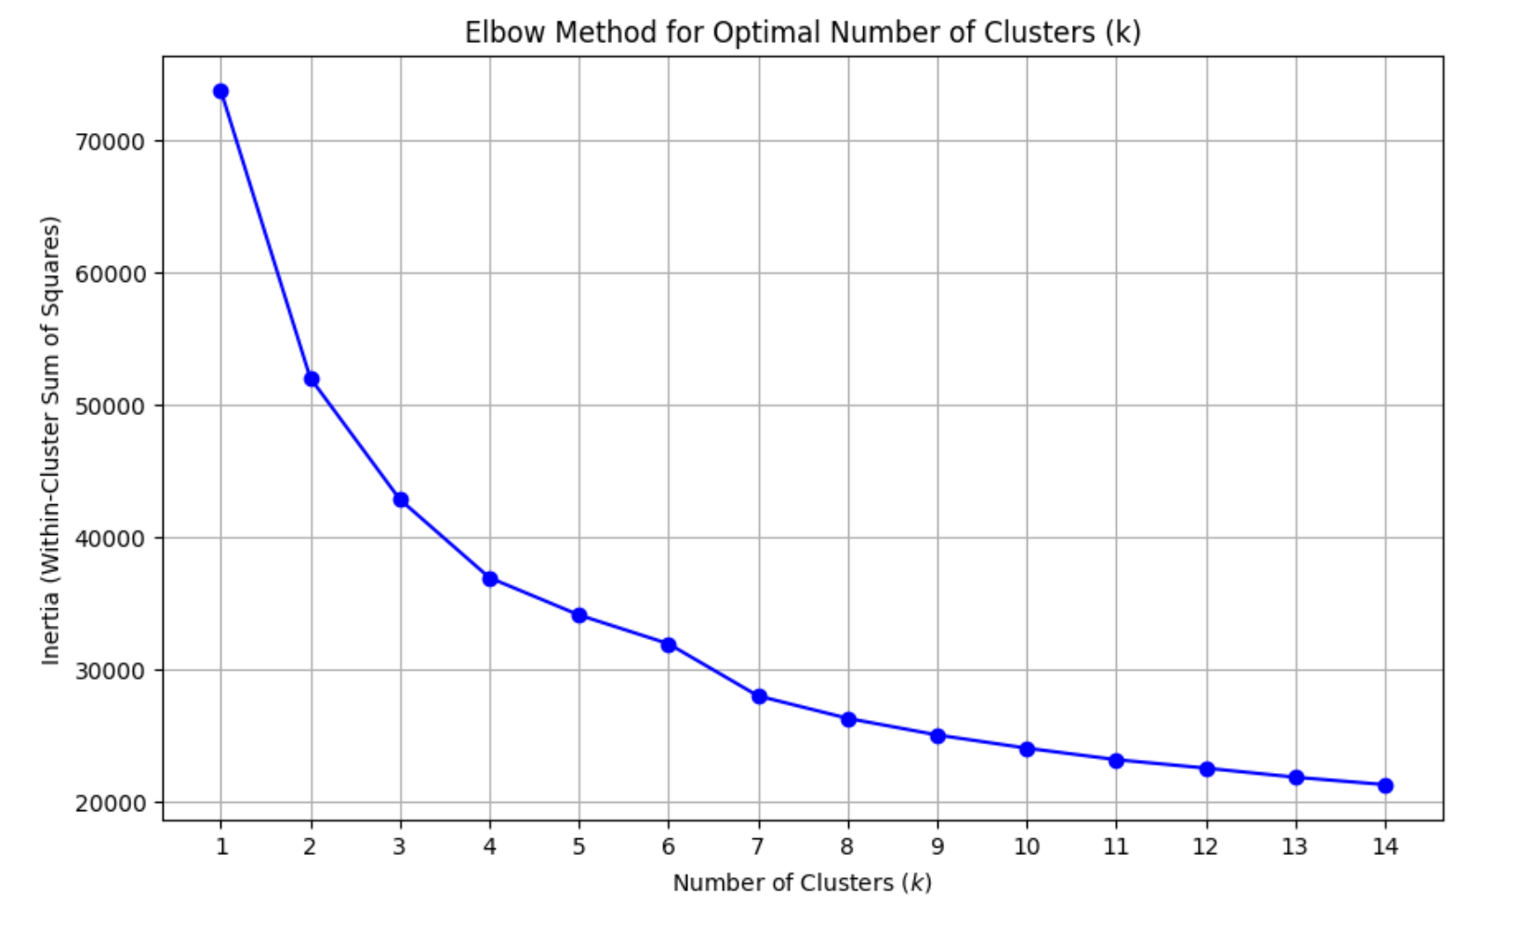
Methodology: Finding the Optimal *k*
K=3(Elbow)
The Elbow Method shows a sharp drop in inertia (sum of squared distances) until k=3. After this "elbow" point, the improvement flattens, indicating that **3** is the optimal number of clusters.

Slide 9
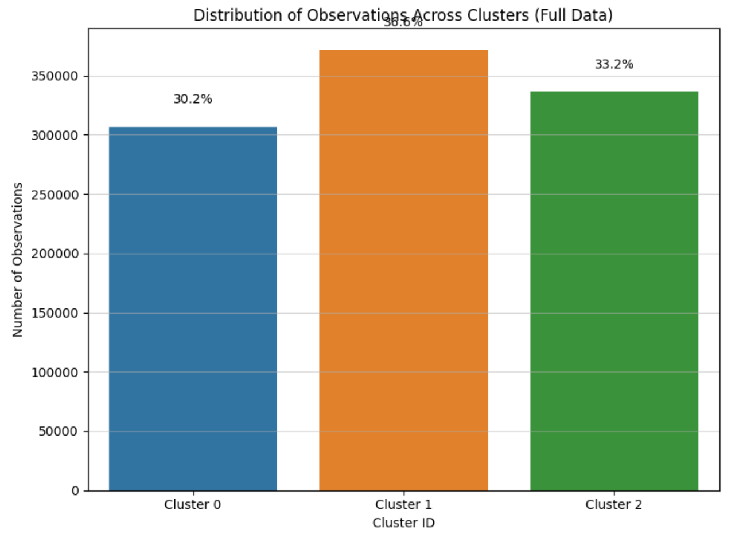
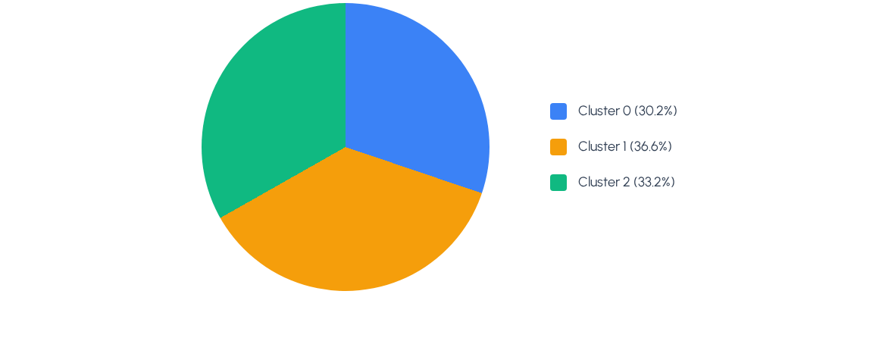
Cluster Validation & Distribution
Running K-Means with k=3 resulted in three distinct and well-balanced clusters, each representing a significant portion of the ~1 million participants.

Slide 10
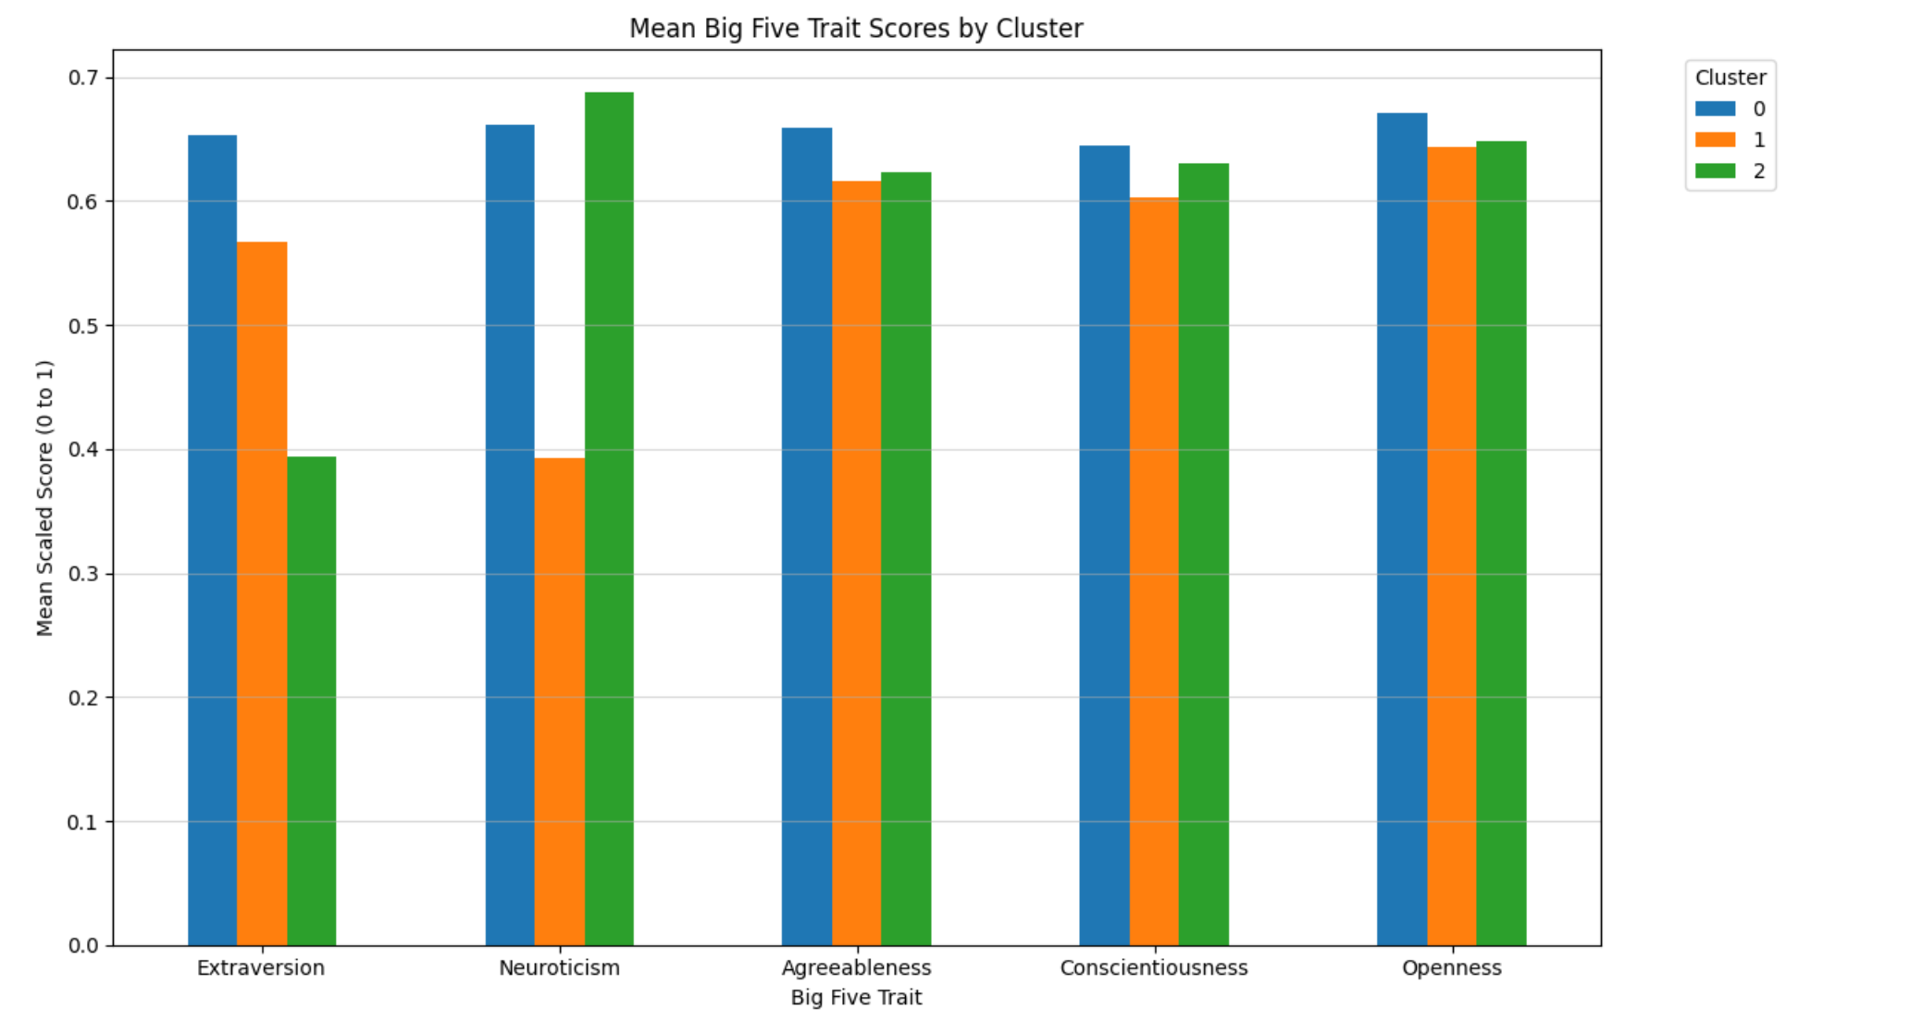
Cluster Profiles: Mean Trait Scores
Cluster 0
Cluster 1
Cluster 2
This chart shows the unique personality profile of each cluster based on their average trait scores. *Note: Data shown matches the project's final interpretation.*

Slide 11






The Three Personality Profiles
Cluster 0: The Spontaneous
Cluster 1: The Social & Adventurous
Cluster 2: The Dependable
This group is defined by its **very low score in Conscientiousness**. They are easy-going, impulsive, and sometimes careless, while average in other traits.
This group is defined by its **high scores in Extraversion and Openness**. They are energetic, curious, and thrive on social interaction and new experiences.
This "stable and reliable" group has **high Agreeableness**, **high Conscientiousness**, and **very low Neuroticism** (emotionally secure).

Slide 12
Applying the Model to a New Subject
Testing the Model
DEMO
As a final test, I ran my own responses through the trained K-Means model.
The model analyzed my 5 trait scores and assigned a cluster.
My Predicted Profile:
Cluster 1: The Social and Adventurous

